Slide 1
Design Proposal for 5.5kW HV PTC Heater
“ 생각을 바꾸고 연구소를 다시 만든다 ”
WOORY

Slide 2
PTC Heater Electric Generals
Two Zone :
- PTC Heater Performance : 5.5kW ±5%
- HV & LV circuits are in One PCB Board
Ingress Protection : IP67
Heating Rod type : Aluminum tube type
Fin Type : Brazing Fin (Separated type)
Connector Type : Direct Connector HV, LV (IP67)
- HV Connector : APTIV 35415839
→ Mating Connector : APTIV 35415834
- LV Connector : KET MG651098-5
→ Mating Connector : KET MG641101-5
Chassis GND is necessary to meet the EMC spec.
Zone 1
Zone 2

Slide 3
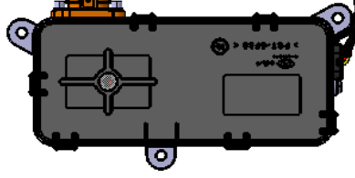
PTC Heater Dual Zone Concept
General Specification
175
No | Item | Unit | Spec | Remark
1 | Size(L x H x T) | mm | 269 x 134 x 32 | Core part
 |  |  | 175 x 78 X 40 | Control part
2 | Power (0℃, 300kg/h, 357V) | kW | 5.5 ±5% | -
3 | Steady Current | A | 15.4A ±5% | @Nominal condition
4 | Inrush Current | A | Max. 20A | -
5 | Pressure Drop | Pa | MAX 115Pa | -
6 | Normal Voltage | Vdc | 358 | -
7 | HV Range | Vdc | 150~432V | -
8 | LV Range | Vdc | 8 ~ 18 | -
9 | Communication | - | High Speed CAN | -
11 | Operating Temperature | ℃ | -40 to 85 | -
12 | Storage Temperature | ℃ | -40 to 105 | -
13 | IP Rate | - | IP 67 | -
78
40
269
134
32

Slide 4
PTC Heater Dual Zone
■ Exploded View
■ Part List
19-1
No |  | Item | Q’ty | Remark
1 |  | NAME PLATE | 1
2 |  | WARNING LABEL | 1
3 |  | COVER | 1
4 |  | VENT FILTER | 1
5 |  | MAIN PCB ASS’Y | 1
6 |  | CHASSIS GROUND WIRE ASS’Y | 1
7 |  | HV CONNECTOR ASSY | 1
8 |  | SIGNAL CONNECTOR ASS’Y | 1
9 |  | JOIN BOARD ASS’Y | 1
10 |  | SEALANT | 1
11 |  | IGBT PAD | 1
12 |  | IGBT | 3
13 |  | UPPER HOUSING ASS’Y | 1
14 |  | SIDE BAR | 2
15 |  | LOWER HOUSING | 1
16 |  | HEAT CORE ASS’Y | 1
17 |  | BRAZING FIN - A | 11
18 |  | BRAZING FIN - B | 3
19 |  | HEAT ROD ASS’Y | 6
 | 1 | AL TUBE | 1
 | 2 | INSULATION PAD | 2
 | 3 | TERMINAL UPPER | 2
 | 4 | PTC STONE | 8
 | 5 | STONE HOLDER | 1
 | 6 | TERMINAL LOWER | 2
20 |  | UPPER GROMMET | 1
21 |  | SPONGE | 1
22 |  | CORE JOIN FIXTURE | 1
23 |  | TEMPSENSOR FIXTURE | 2
비고
19-2
19-3
1
19-4
2
19-5
3
5
4
19-6
9
12
8
11
18
10
6
13
17
20
23
7
16
19
22
14
15
21

Slide 5
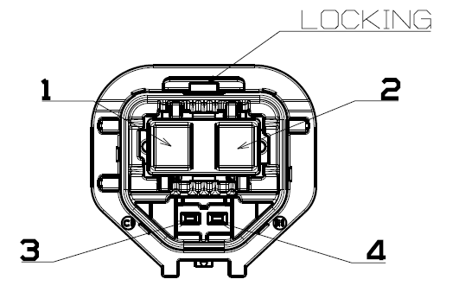
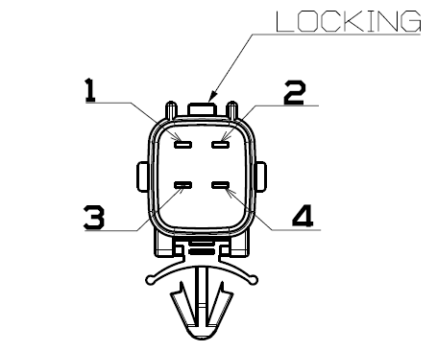
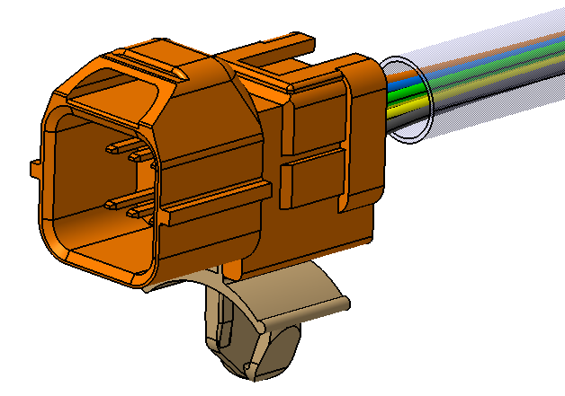
HV & LV Connector information
■ Connectors & Pin map
Connector | Part number | Pin No. | Pin name | Remark
HV Connector | APTIV 35415839 (Mating : Aptiv 35415834) | 1 | HV(+)
 |  | 2 | HV(-)
 |  | 3 | Interlock(+) – HV PTC
 |  | 4 | Interlock(-) – HV PTC
LV Connector | KET MG 651098-5 (Mating : KET MG 641101-5) | 1 | IGN3
 |  | 2 | CAN HIGH
 |  | 3 | CAN LOW
 |  | 4 | GND

Slide 6
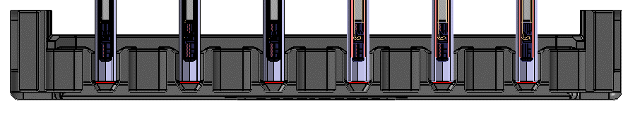
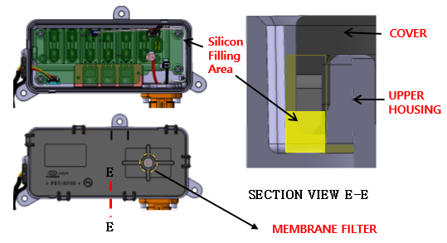
IP Waterproof structure
A
실리콘 충진 부
HEAT ROD
HV CONNECTOR |  | LV CONNECTOR
COVER
A
UPPER HOUSING
HEAT ROD
GROMMET
SIGNAL CONNECTOR
COVER
MEMBRANE
FILTER
A
SECTION VIEW A-A
Silicon Filling Area
ROD ASS’Y
B
B
LOWER HOUSING
SECTION VIEW B-B
HV
CONNECTOR
HV GROMMET
LV GROMMET
UPPER HOUSING
C
D
UPPER HOUSING
D
C
SECTION VIEW C-C
SECTION VIEW D-D
HEAT ROD
SECTION VIEW E-E

Slide 7
Mounting Direction & air flow direction
HVAC MT’G Direction
AIR FLOW
AIR FLOW

Slide 8
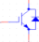

Block diagram
BLOCK DIAGRAM
Chassis GND
Interlock
HV(+)
Isolation
HV(-)
Connector
A
T
C
U
LV circuit
Connector
HV circuit
ELEC - CAPCITOR
DC/DC
Switching IC
Transformer
High Voltage Sensing
Core Ass’y
IGN(+)
MCU
Regulator
GND(-)
LC Filter
Sidebar Temp Sensor1
LV Sensing
Digital
Isolator
Core FIN
Connector
Gate Driver
IGBT1
Regulator
CAN_ H
CAN
Transceiver
TXD
Core FIN
CAN_ L
RXD
Gate Driver
IGBT2
Sidebar Temp Sensor2
Core FIN
Gate Driver
IGBT3
Interlock
Core FIN
Current Sensing1
Shunt1
Current Sensing2
Shunt2
PCB Temp Sensor

Slide 9
Protect Functions
NO | ITEM | Specification | Logic | Functions
1 | LV under Voltage | LV Voltage ≤ 8V (Hysteresis 1.0V) |  | protecting over discharging of the LV Batt Protecting abnormal operating in the under voltage condition of LV
2 | LV Over Voltage | LV Voltage ≥ 17V (Hysteresis 1.0V) |  | Protecting abnormal operating in the over voltage condition of LV
3 | HV under Voltage | HV Voltage ≤ 150V (Hysteresis 20V) |  | Protecting rapid discharging of the HV Battery Protecting abnormal operating in the under voltage condition of HV
4 | HV Over Voltage | HV Voltage ≥ 432V (Hysteresis 20V) |  | Protecting abnormal operating in the over voltage condition of HV
5 | HV Over Current | HV Over Current ≥ TBD |  | Do not exceed 14A by controlling the performance by itself. (Each Zone) Protecting PTC heater from over current conditions (Each Zone)
6 | PCB Over Temp | PCB Temp ≥ 105℃ (Hysteresis 10℃) |  | Protecting PTC heater circuits from its heat.
7 | Core Over Temp | Core Temp ≤ 95℃ Core Temp ≥ 105℃ (Hysteresis 10℃) |  | Protecting PTC heater circuits from its heat. Reduces performance according to overheating temperature
8V (TBD)
RUN
STOP
9V (TBD)
RUN
18V (TBD)
17V (TBD)
STOP
150V (TBD)
RUN
STOP
170V (TBD)
RUN
432V (TBD)
412V (TBD)
STOP
RUN
14A (TBD)
after 10sec
STOP
RUN
STOP
95℃
105℃
RUN
STOP
95℃ (TBD)
105℃(TBD)

Slide 10
Product Specifications
■ Product Specifications Review : Introduction to Key Features
No | Function | Description | Remark
1 | Power Control | - Pulse Width Modulation (6Hz) - The period is kept constant while the ON time (pulse width, duty cycle) is adjusted.
2 | Consumption Power Control | Power Mode : Linear power control according to watt command Max Stable Current Control Max Inrush Current Control
3 | Communication | LIN Communication
4 | Monitoring | LV, HV Voltage Monitoring HV Current monitoring Consumption Power Monitoring PCB & core temp sensor temperature monitoring | Need to define within LIN Spec Data List
5 | Protection Function | - LV Out of Range fault (Under / Over Voltage) - HV Under / Over Voltage fault - HV Over Current fault PCB / Over Temperature fault Temp Sensors (Core part) / Over Temperature fault Communication Error fault control | See next page
6 | Failure Detection | Sensor Failures (HV, HV Current, Temp Sensors) IGBT Short failure | See next page

Slide 11
LIN Communication List
◎ OPERATION FeedBack List
ITEM | DETAIL | NOTE
IGBT Operating Frequency Duty (%) | Feedback on ther current frequency applied to IGBT
Operating Power (%) | Feedback on the current power as a percentage
Operating Power (W) | Feedback on the current power
Operating Current (A) | Feedback on the current current
◎ Failure List
ITEM | DETAIL | NOTE
CoreTempSensor | Core temperature sensor failure
HighVoltSensor | High voltage sensor
LowVoltSensor | Low voltage sensor
PcbTempSensor | PCB temperature sensor
IGBT | IGBT failure in eachr zone
OverCurrent | Over Current failure
HVHigh | Over voltage failure in high voltage
HVLow | Low voltage failure in high voltage
LVHigh | Over voltage failure in low voltage
LVLow | Low voltage failure in low voltage
PcbOverTemp | PCB temperature overheating failure
CoreOverTemp | Core temperature overheating failure
CAN Communication Timeout | CAN communication timeout failure
InterLock | Interlock not inserted failure

Slide 12
Other Information
NO | Item | Description
1 | ISO 26262 Status | - ASIL B achieved in another project
Question
1 | ISO-21434 (Cyber Security) | - Cyber Security is applied (Y/N)
2 | A-SPICE | - A-SPICE is appliedis applied (Y/N)

